Slide 1


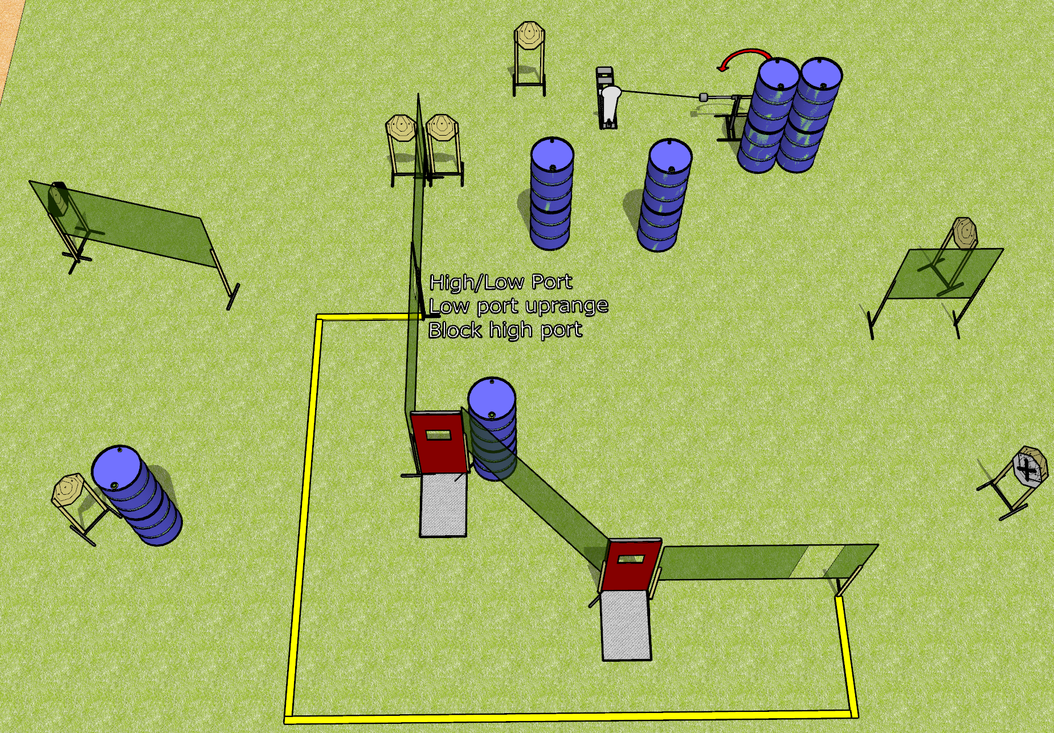
 | Dothan Gun Club – USPSA Match Just Why Course Designer : Drew Coleman
Round Count 17 rounds 8 IPSC 1 colt popper
Equipment List 11 wall feet 2 pull down ports Swinger + activator 1 tux, 8 targets (7 + 1 NS)

Slide 2
Just Why
Written Stage Briefing
Just Why is a 17 round, 85-point, Comstock course of fire. There are 8 IPSC targets and 1 steel. The best 2 hits on carboard will score.
Handgun start position is anywhere completely outside the shooting area, wrists below belt. Handgun is loaded and holstered.
PCC start position is anywhere completely outside the shooting area, stock on belt. Loaded carbine is held with both hands, safety on belt.
On the audible start signal, engage targets as they become available from within the shooting area.

